Slide 1
REMOTE PC CONTROLLER
P.Robin 951112104015
C.Mahesh 951112104010
I.Kalaiponraj 951112104007
Guided By,
Mr.A.Albert Lenin M.C.A, M.E.,
HOD/CSE

Slide 2
ABSTRACT
Remote control systems are a very useful element to control and monitor devices quickly and easily.
The main idea behind the proposed architecture was the design of a system to be used as a platform which provides the services needed to perform remote control of mobile devices.
Existing system makes use of android mobiles, USB and internet to remotely control the Personal Computer connected.
It monitors and controls the computer’s activities and switches between internet and USB based on the speed requirement.
It uses compression and decompression concepts.
Proposed system uses similar concepts using Wi-Fi for network.
Compression concepts are not used to reduce processor load in android mobiles.
Interpretation concepts are used instead.

Slide 3
INTRODUCTION
The standard input devices of a computer are keyboard and mouse. It takes space and maintenance is difficult. On the other hand android phones are quite popular in market. It comes packed with powerful processors, large displays and reliable networking hardware which is enough to act as a virtual keyboard and a touchpad. We are using these features to our advantage. A communication link is established between client mobile and server PC. The inputs given on mobile are converted into small signals and sent to computer. The computer receives these signals and emulates keyboard and mouse actions accordingly. This type of computing is called Virtual Network Computing(VNC).

Slide 4
LITERATURE SURVEY#1
TITLE : Design and Application of Remote Control System Using Mobile Phone with JNI Interface
AUTHOR : Lingyan Bi, Weining Wang,Haobin Zhong, Wenxuan Liu
YEAR :2008
FEATURES :
This methodology introduces a scheme which uses mobile phone to power point play in computer without installing any program in mobile phone. It uses JNI technology to control the Windows system's function.
IDENTIFICATION :
It only has control over power point application. It does not provides control over other applications.

Slide 5
LITERATURE SURVEY#2
TITLE : VNC-based Remote Control for Symbian OS smartphones
AUTHOR : Adam, Skurski, Bartlomiej Swiercz
YEAR :2009
FEATURES :
It implements a VNC server application for the Symbian OS based devices . Automatic test environment is established.VNC server is dedicated to the S60 environment and it is independent on the hardware specification, such us screen resolution or keyboard type.
IDENTIFICATION :
It failed to provide enough security in the networking interface.

Slide 6
LITERATURE SURVEY#3
TITLE : Improving Video Performance In VNC Under High Latency Conditions
AUTHOR : Cynthia Taylor, Joseph Pasquale
YEAR :2010
FEATURES :
It proposes a PC application remote control system via mobile phones. This PC application remote control system that does not rely on specific devices and software.
IDENTIFICATION :
It failed as it focuses on increasing speed of signals rather than quality of information transferred.

Slide 7
LITERATURE SURVEY#4
TITLE : Design of remote control system for PC based on MCU
AUTHOR : B. X. Lin,W. Min
YEAR :2012
FEATURES :
This design based on infrared codes.Real-time data sent by the microcontroller, contrasting the control code table, Windows API to send a message,implementing the direct operation of a separate application.
IDENTIFICATION :
It does not provide reliability and speed is very less for this kind of applications

Slide 8
LITERATURE SURVEY#5
TITLE : Remote Control of Mobile Devices in Android Platform
AUTHOR : Angel Gonzalez Villan , Josep Jorba Esteve
YEAR :2013
FEATURES :
The aim of this approach is to make remote pc control faster and more accessible by using either USB wired interface or internet.This approach uses compression strategies to provide real time desktop control and monitoring.

Slide 9
EXISTING SYSTEM
Virtual Network Computing system where mobile devices are considered servers to gain full access and control over a network.
Mobile devices are considered as server which receives information from the network to operate accordingly.
The connection is made between client and server using USB interface/Internet provided IP and Port.
USB interface uses ADB drivers for mobile devices which is specified by the manufacturers based on the type and design of the processor used.
Incase of internet. A reliable, highspeed and stable network is mandatory for Real-time Signal Reception and Processing.

Slide 10
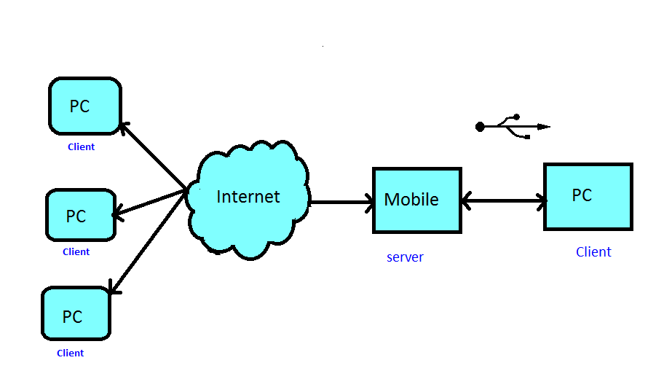
EXISTING SYSTEM

Slide 11
EXISTING SYSTEM
DISADVANTAGES
Android Debug Bridge(ADB) is a driver software required for PC-Android interface. Every device has its own ADB driver, also most devices don’t have ABD driver specified by manufacturer.
Internet communication is unstable, complex and inefficient which is not suitable for such applications.
USB interface cannot take full control of PCs. Its functions are limited to basic functions like shell execution ,port forwarding & File managements, e.t.c

Slide 12
PROPOSED SYSTEM
Wi-Fi communication is used in place of other networks.
Client-Server Architecture is implemented.
Mobile devices are taken clients to reduce the overhead in processor, since most mobiles don’t have decent processor.
Computer system is kept as server to process heavy tasks related to emulation.
Gesture Listeners and Click Listeners are used for recording mobile input and doing related operations.
Java socket programming on both ends for achieving a communication link.
Emulation programming is Aided by java Robot class aids remote PC controls.

Slide 13
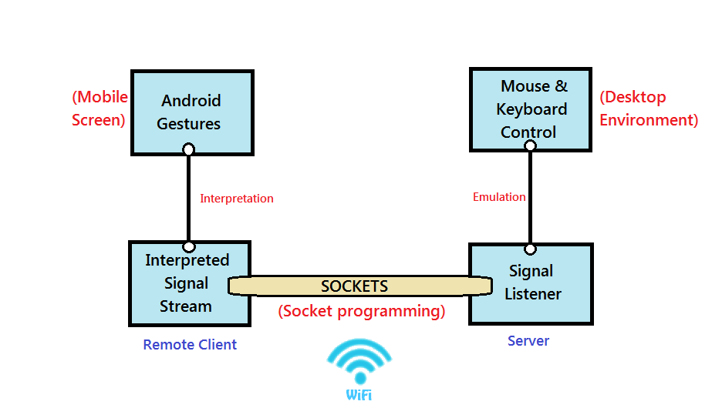
PROPOSED SYSTEM

Slide 14
PROPOSED SYSTEM
WORKING:
STEP 1:Establish connection(IP, Port, Password)
STEP 2:Get gesture as input(buttons, gestures, e.t.c)
STEP 3:Gesture to signal conversion(numeric values)
STEP 4:Transfer signal using sockets to PC
STEP 5:Convert signal to emulation(using Robot class)
STEP 6:check Connection/Service availability
if (true) Goto ‘STEP 2’
else break Control Scope
STEP 7:Terminate connection

Slide 15
MODULES
Socket Management with Network:
Sockets are basic elements in a network communication which acts as end points for a device or instance. Server socket is created by using a port number and a session timeout value.
Asynchronous Task management:
TCP connections cannot run in the same thread as GUI as they both interfere with each other’s process. To make network process and GUI independent of each other Asynchronous Tasks are used.
Robot Class/Methods Implementation:
Robot class is a concept in java which are designed to virtually emulate mouse movements and key press in computers. So signal are mapped with Robot key definitions.

Slide 16
MODULES
GUI with Gesture Management and Permissions:
Gestures are combinations of touch positions used in touch devices. Gestures are registered and their actions are defined. Permissions are required for a application to control phone’s functions which is specified in a Manifest file.
Deployment of Platform Oriented Packages:
Since java is platform independent. A JAR(Java Archive) for all operating systems, an EXE(Executable) setup for windows system and an APK(Android Package) for androids are exported from the IDE.

Slide 17
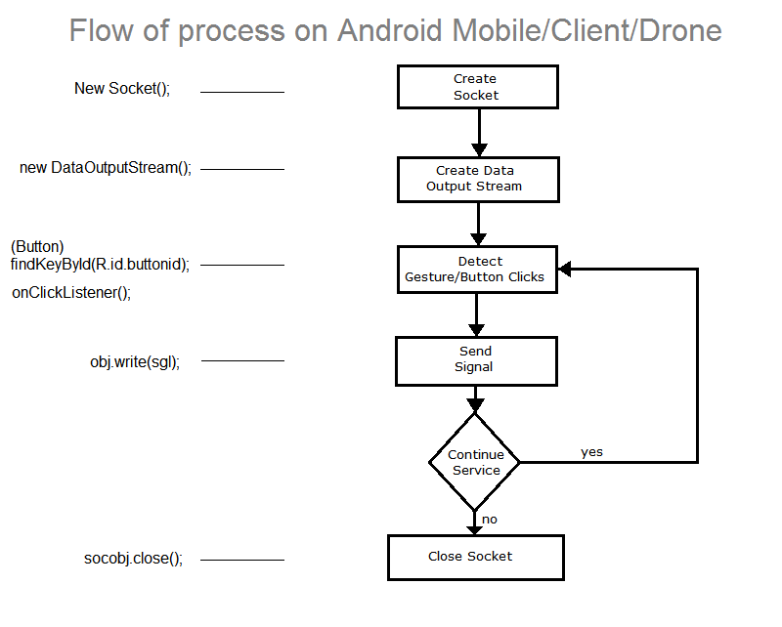
FLOW DIAGRAM

Slide 18
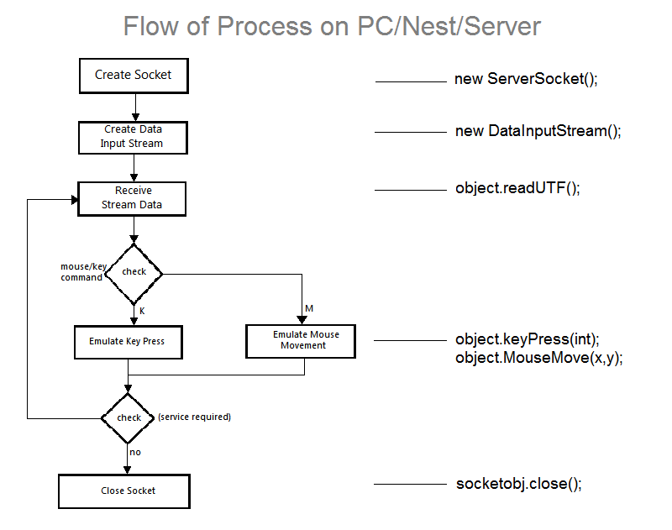
FLOW DIAGRAM

Slide 19
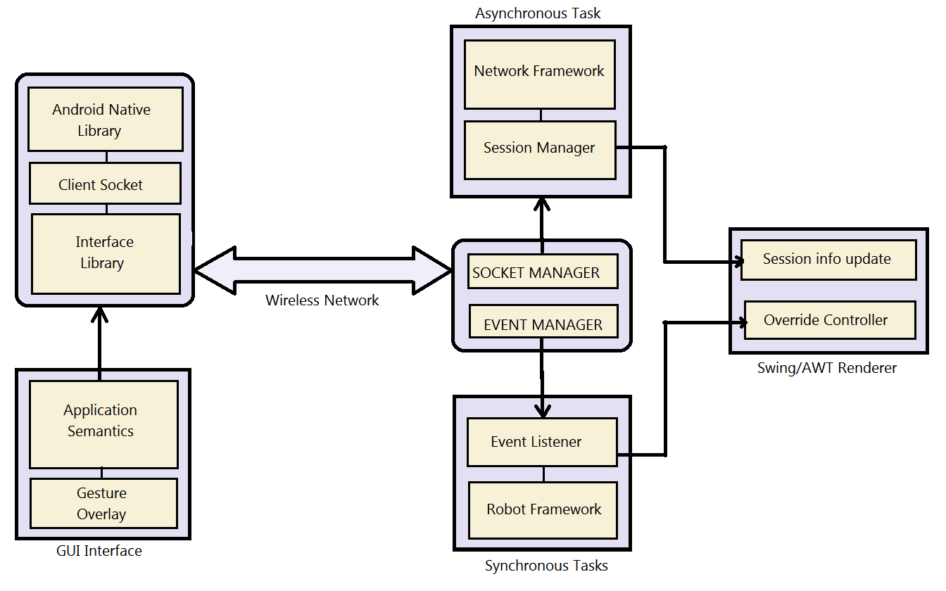
SYSTEM ARCHITECTURE

Slide 20
ADVANTAGES
Wi-Fi is dynamic-switching between devices are easy and fast.
Wi-Fi devices are more common nowadays. Hence no additional hardware and drivers are not required.
Wi-Fi is more portable than USB hence user can control computers from anywhere easily.
Wi-Fi is more stable and reliable than internet.
Using signals are faster than compressed data formats which improves the speed of controls.

Slide 21
APPLICATIONS
1.FUNCTIONAL BENEFITS:
Many Systems can be controlled using one mobile device. It may change the face of technology and the view of input devices.
Compulsory paring method enhances security of devices. Only one phone is allowed to pair with the PC for security purpose.
It is simple for basic users to understand and imply.

Slide 22
APPLICATIONS
2.NON-FUNCTIONAL BENEFITS:
It saves space-Many mouse and keyboards can be replaced by one small size mobile.
Maintenance is easy along with less power usage.
3.HEALTH BENEFITS:
Less reduction in eye power due to increased distance to monitor.
Other health problems due to prolonged postures like neck pain and back pain are avoided.

Slide 23
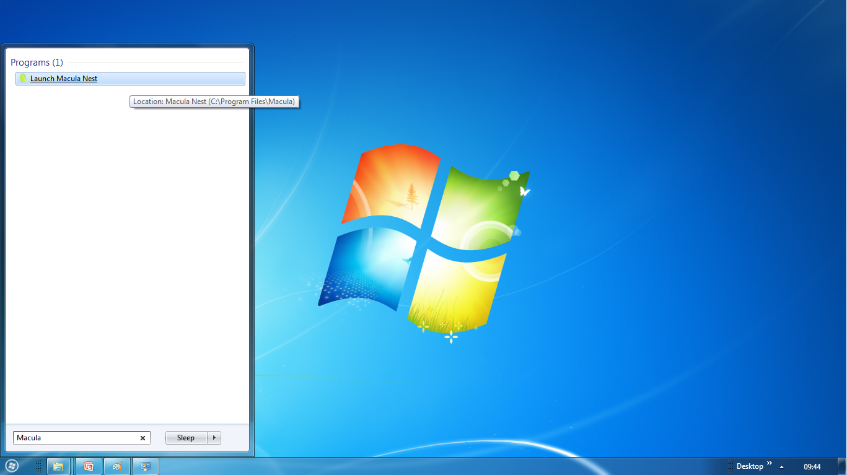
SCREENSHOTS

Slide 24
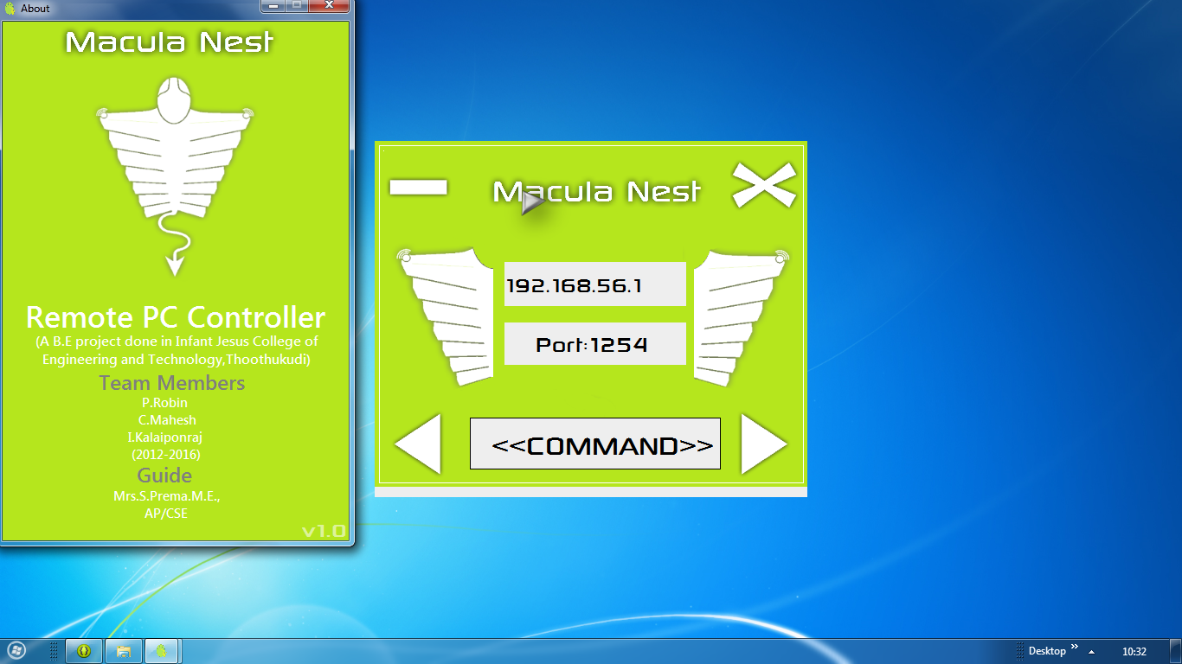
SCREENSHOTS

Slide 25
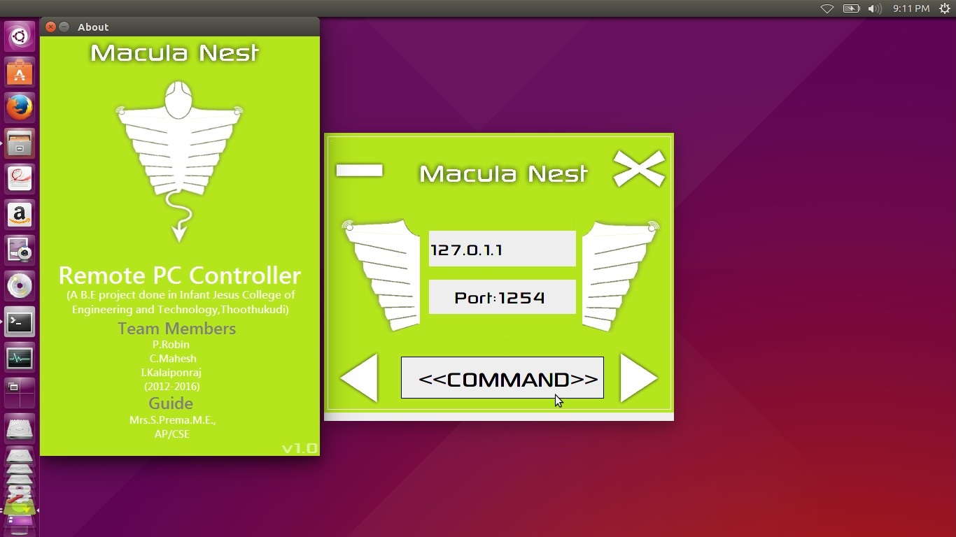
SCREENSHOTS

Slide 26
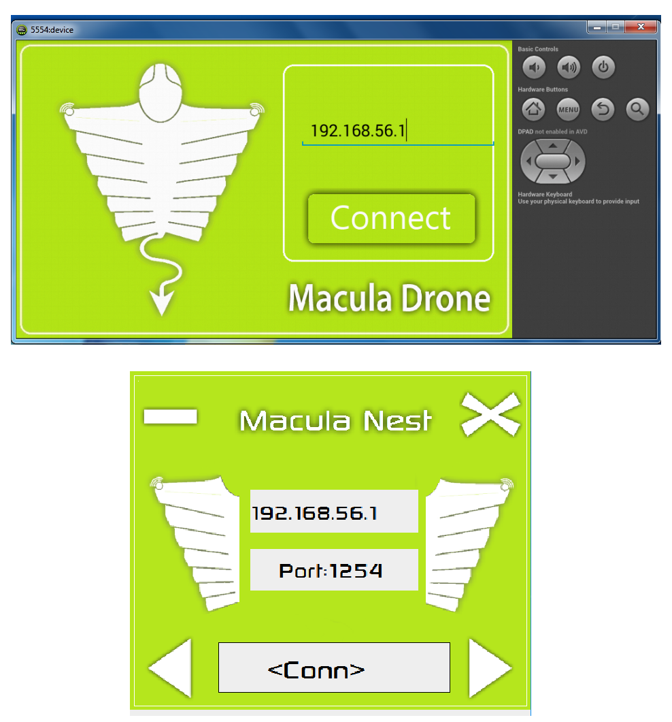
SCREENSHOTS

Slide 27
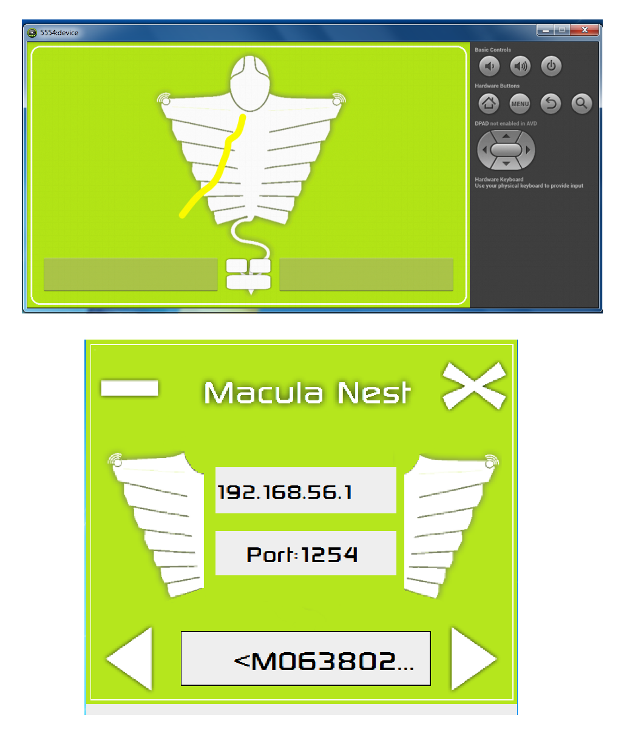
SCREENSHOTS

Slide 28
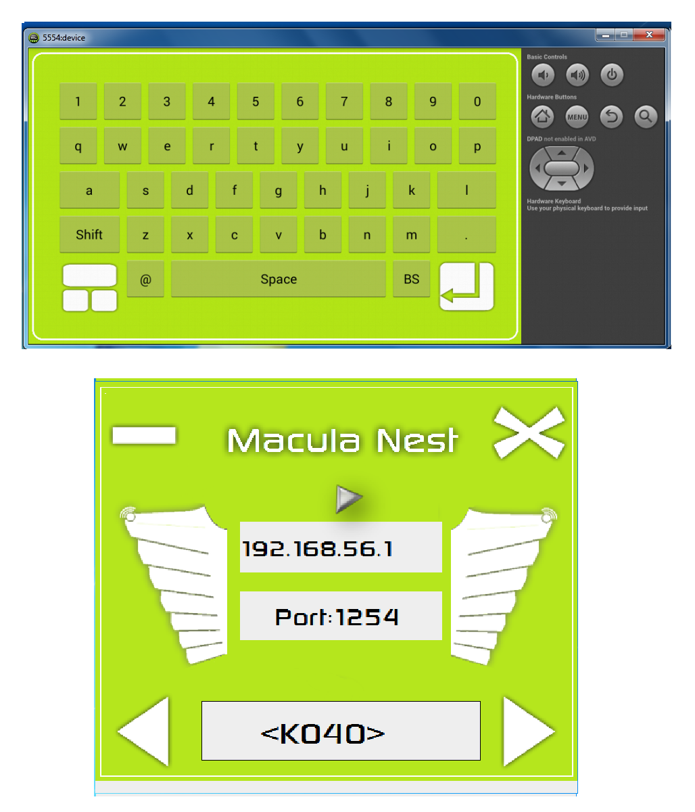
SCREENSHOTS

Slide 29
SYSTEM REQUIREMENT
Personal Computer:
RAM : 1 GB or above
OS : Windows XP or above
S/W and Drivers : JRE 1.6.0_3 or above
Network Adaptor : Dynamic WLAN Host Adaptor
Android Mobile:
OS : API 14(4.0) or above
Screen Resolution : Atleast 800x480 plx
Network Adaptors : Embedded Wi-Fi adaptor
RAM : Atleast 512mb with GPU, Dualcore

Slide 30
REFERENCES
Singhal,A;and Umar,S,”Application Remote Control using Bluetooth”,International Conferences on Advanced Computer Control,2008.IEEE transactions on Mobile computing,2011.
Enck, W., Ongtang, M., McDaniel, P., "Understanding Android Security", Security & Privacy, IEEE, Jan.-Feb. 2009, Volume 7,Issue 1, pp.50-57
“Mobile Web-Based System For Remote-Controlled Electronic Devices and Smart objects “,Jordan Pascual Espada & Vincente Garcia-Diaz & Ruben Gonzalez Crespo & Oscar Sanjunan Martinez & B.Ccristina Palyo G-Bustelo & Juan Manuel Cueva Lvelle,Published Online:28 May 2014,Springer Science+Business Media New York 2014.
Sareddy Deepthi, A.Vasanthi,”Mobile Phone Controlling PC-A Review”,IJCSMC, vol.1,Issue.1,December 2012.

Slide 31
CONCLUSION
Wireless Technology is an inevitable part of modern digital world.
Combining wireless concepts with input devices may change the view of input devices.
It may benefitting concurrent mobile/PC users by reducing time, distance and physical visit.

Slide 32
FUTURE ENHANCEMENT
This Project focuses on most basic input devices(Mouse and Keyboard).
Future work can add more input devices like finger-print scanner, QR-code scanner, e.t.c…

